Slide 1

MIOSHA Update
Hazard Communication Training
Including GHS Revisions

Slide 2
Objectives
Overview of changes to the MIOSHA Part 42, 92 and 430: Hazard Communication Standard (Haz Com)
Labeling requirements
Safety Data Sheets (SDS) format – 16 sections

Slide 3

Why the Change to Haz Com?
To align with the Globally Harmonized System of Classification and Labeling of Chemicals (GHS) adopted by 67 nations
To provide a common and coherent approach to classifying chemicals
Reduce confusion and increase understanding of the hazards
Facilitate training
Help address literacy problems

Slide 4

Who is Affected?
Manufacturers, Distributors, Importers
  Change SDS information and format
  Change container labeling
Employers
Training employees on changes to:
  SDS (change from MSDS to SDS and 16-section format)
  Container Labels (including secondary containers)
Employees
Recognize and understand hazards based on:
  Information in new SDS format
  Pictograms on container labels
  Precautionary and hazard statements

Slide 5
Effective Dates and Requirements
Effective Completion Date | Requirement(s) | Responsible Party
December 1, 2013 | Train employees on the new label elements and SDS format | Employers
June 1, 2015 | Compliance with all modified provisions of the final rule except: | Chemical manufacturers, importers, distributors, and employers
December 1, 2015 | The distributor shall not ship containers labeled by the chemical manufacturer or importer unless it is a GHS label | Distributor
June 1, 2016 | Update alternative workplace labeling and hazard communication program as necessary, and provide additional employee training for newly identified hazards [and affected vertical standard specific signage] | Employer
Transition Period: 12/2012 to the effective completion dates noted above | May comply with either MIOSHA Part 42, 92 and 430 (final standard), or the current standard, or both | Chemical manufacturers, importers, distributors, and employers

Slide 6
Chemical Classifications
Chemicals will be classified using a harmonized system that provides standardized language for:
  Health Hazard Categories
  Physical Hazard Categories
  Environmental Hazard Categories*
*Not regulated by MIOSHA.

Slide 7
Chemical Classifications:
Health Hazards
Acute Toxicity
Skin Corrosion/Irritation
Respiratory or Skin Sensitization
Germ Cell Mutagenicity
Carcinogenicity
Reproductive Toxicity
Specific Target Organ Toxicity – Single Exposure
Specific Target Organ Toxicity – Repeated Exposure
Aspiration
Simple Asphyxiants

Slide 8
Chemical Classifications:
Health Hazards
Health Hazards
Hazard Class | Hazard Category
Acute toxicity | 1 | 2 | 3 | 4
Skin Corrosion/Irritation | 1A | 1B | 1C | 2
Serious Eye Damage/Eye Irritation | 1 | 2A | 2B
Respiratory or Skin Sensitization | 1
Germ Cell Mutagenicity | 1A | 1B | 2
Carcinogenicity | 1A | 1B | 2
Reproductive Toxicity | 1A | 1B | 2 | Lactation
Specific Target Organ Toxicity – Single Exposure | 1 | 2 | 3
Specific Target Organ Toxicity – Repeated Exposure | 1 | 2
Aspiration | 1
Simple Asphyxiants | Single Category

Slide 9

Chemical Classifications:
Physical Hazards
Flammable Liquids
Flammable Solids
Self-Reactive Chemicals
Pyrophoric Liquids
Pyrophoric Solid
Pyrophoric Gases
Self-heating Chemicals
Chemicals, which in contact with water, emit flammable gases

Slide 10
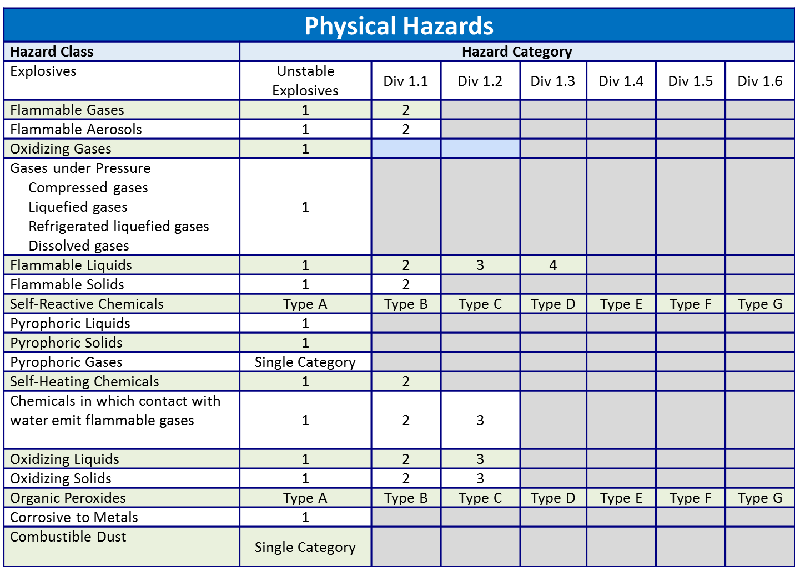
Chemical Classifications:

Slide 11
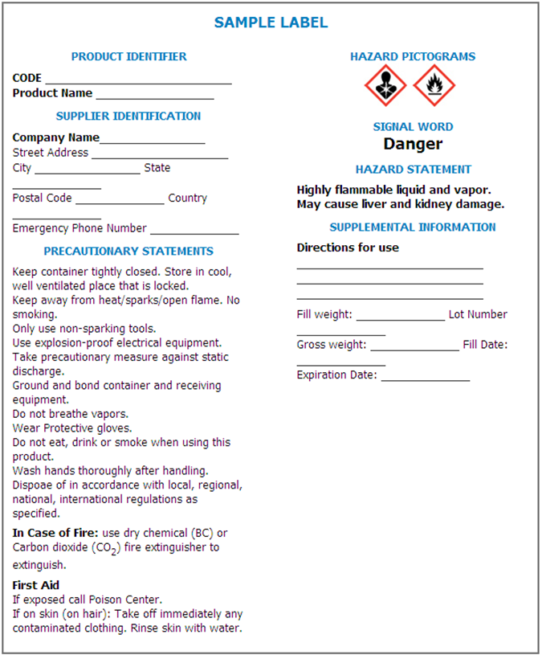
Labels
There are several new label elements:
Symbols called “Pictograms”
Signal Words
Hazard Statements
Precautionary Statements
Product Identification
Supplier/Manufacturer Identification

Slide 12
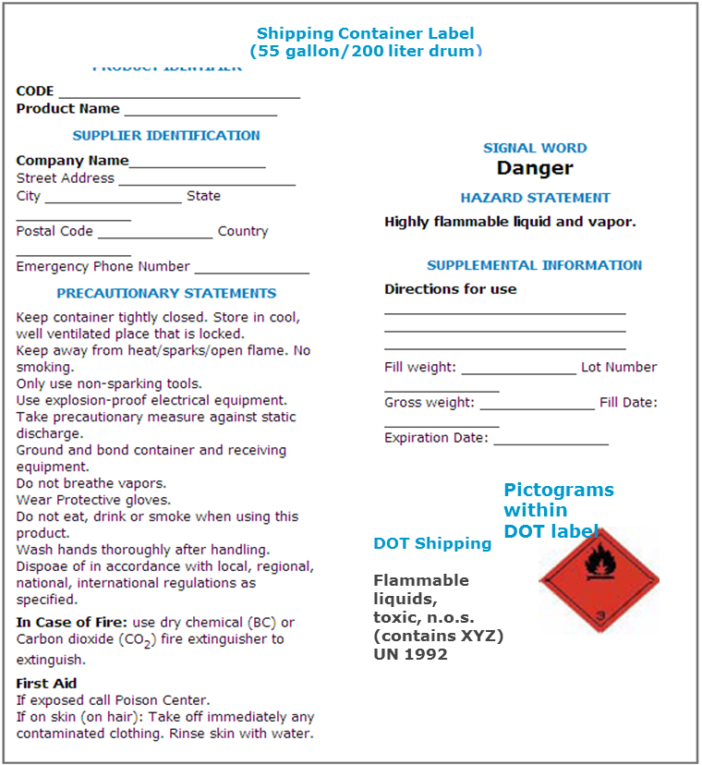

Labels: Shipping
Effective June 1, 2015 all shipping labels will be required to have all GHS label elements

Slide 13














Transport "Pictograms"
Flammable Liquid Flammable Gas Flammable Aerosol | Flammable solid Self-Reactive Substances | Pyrophorics (Spontaneously Combustible) Self-Heating Substances
Substances, which in contact with water, emit flammable gases (Dangerous When Wet) | Oxidizing Gases Oxidizing Liquids Oxidizing Solids | Explosive Divisions 1.1, 1.2, 1.3
Explosive Division 1.4 | Explosive Division 1.5 | Explosive Division 1.6
Compressed Gases | Acute Toxicity (Poison): Oral, Dermal, Inhalation | Corrosive
Marine Pollutant | Organic Peroxides
Notes:
Note the difference in the shipping label compared to the container label on the previous slide. Department of Transportation (DOT) requires that additional information be noted on shipping containers. See bottom right corner of the label for shipping.
MIOSHA requires that employees are knowledgeable of both the container and shipping labels.

Slide 14

Labels: Pictograms
There are 9 pictograms. Only 8 are regulated by MIOSHA
  Health Hazards
  Physical Hazards
  Environmental Hazards (Regulated by DEQ)
DEQ

Slide 15


Labels: Pictograms –
Health Hazards
Acute toxicity (Less Severe):
Irritant
Dermal sensitizer
Acute toxicity (harmful)
Narcotic effects
Respiratory tract irritation
Acute toxicity (Severe)
Acute = short-term effect

Slide 16


Labels: Pictograms –
Health Hazards
Carcinogen
Respiratory sensitizer
Reproductive toxicity
Target organ toxicity
Mutagenicity
Aspiration Hazard
Skin corrosion
Serious eye damage/
Eye irritation

Slide 17


Labels: Pictograms –
Health Hazards
Flammables
Self reactives
Pyrophorics
Self heating
Emits flammable gas
Organic peroxides
Explosives
Self reactives
Organic peroxides

Slide 18


Labels: Pictograms –
Health Hazards
Oxidizer
Corrosive to Metals
Gases under Pressure

Slide 19
Labels: Signal Word
These are words used to indicate the severity of the hazard and alert employees to the potential hazard.
Only 2 signal words will appear:
  “DANGER”(more severe hazard)
  “WARNING” (less severe hazard)
Not all labels will have a signal word. Some chemicals are not hazardous enough to require that a signal word appear on the label.

Slide 20
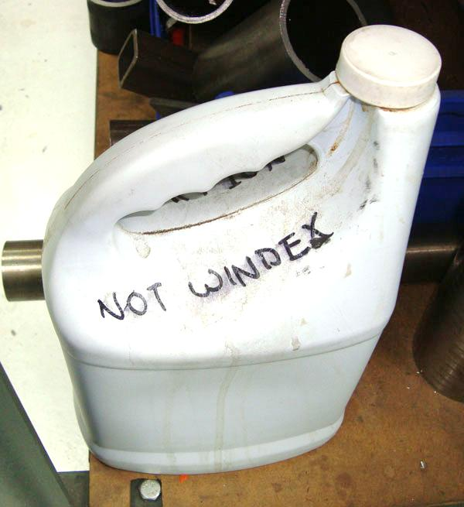
Label: Identification
Product identification (i.e. name of product)
Supplier identification:
  Address
  Telephone number

Slide 21
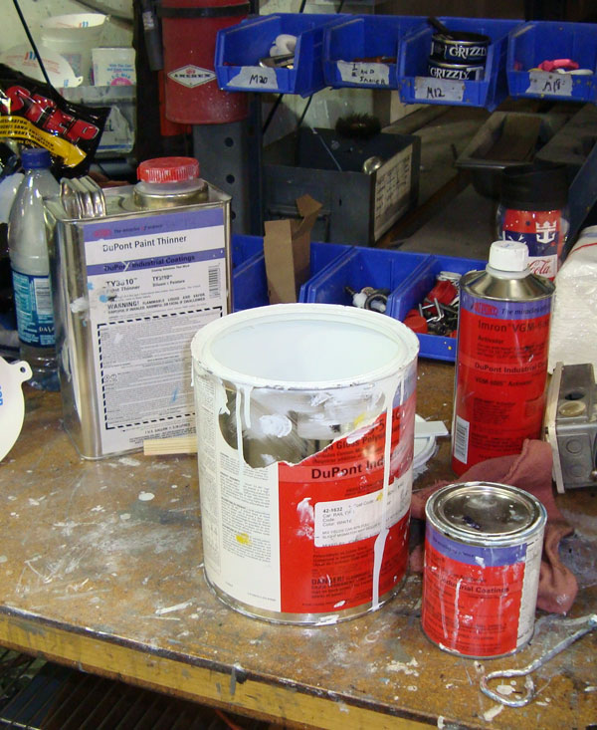
Label: Other information
Other information that may be included on the label:
Physical state
Color
Hazards not otherwise classified
Route of exposure
Storage and disposal
Hazard prevention and emergency
response instructions

Slide 22
Secondary Container Labels
Excerpt from the Hazard Communication Standard (f):
(6) Workplace labeling. Except as provided in paragraphs (7) and (8) of this section, the employer shall ensure that each container of hazardous chemicals in the workplace is labeled, tagged or marked with either:
(i) The information specified under paragraphs (1)(i) through (v) of this section for labels on shipped containers [GHS Label]; or,
(ii) Product identifier and words, pictures, symbols, or combination thereof, which provide at least general information regarding the hazards of the chemicals, and which, in conjunction with the other information immediately available to employees under the hazard communication program, will provide employees with the specific information regarding the physical and health hazards of the hazardous chemical [e.g. HMIS, NFPA or other label system].

Slide 23

Labels: Secondary containers
Must be consistent with the revised Haz Com standard
No conflicting hazard warnings or pictograms.
May use written materials (e.g., signs, placards, etc.) in lieu of affixing labels to individual stationary process containers.
Employer can use GHS compliant labels (same as shipping).
HMIS Label
NFPA Label
HEALTH
Must include notation of chronic health effects
FIRE
PHYSICAL HZ
PPE

Slide 24
Safety Data Sheets
Under the new Haz Com Standard, Material Safety Data Sheets (MSDS) are now called Safety Data Sheets (SDS).
All SDSs will have a consistent 16-section format.
Employers must ensure that SDSs are readily accessible to employees.
MSDS
Safety
Data
Sheets

Slide 25
Safety Data Sheets
New 16-section standardized SDS format required (ANSI Z400.1)
Section 1 – Identification
Section 2 – Hazard(s) identification
Section 3 – Composition / Information on Ingredients
Section 4 – First-aid Measures
Section 5 – Fire-fighting Measures
Section 6 – Accidental Release Measures
Section 7 – Handling and Storage
Section 8 – Exposure Controls / Personal Protection
Section 9 – Physical and Chemical Properties
Section 10 – Stability and Reactivity
Section 11 – Toxicological Information
Section 12 – Ecological Information*
Section 13 – Disposal Consideration*
Section 14 – Transport Information*
Section 15 – Regulatory Information*
Section 16 – Other information including date of preparation of last revision
*Sections outside of MIOSHA jurisdiction but inclusion of these sections is necessary for a GHS compliant SDS

Slide 26

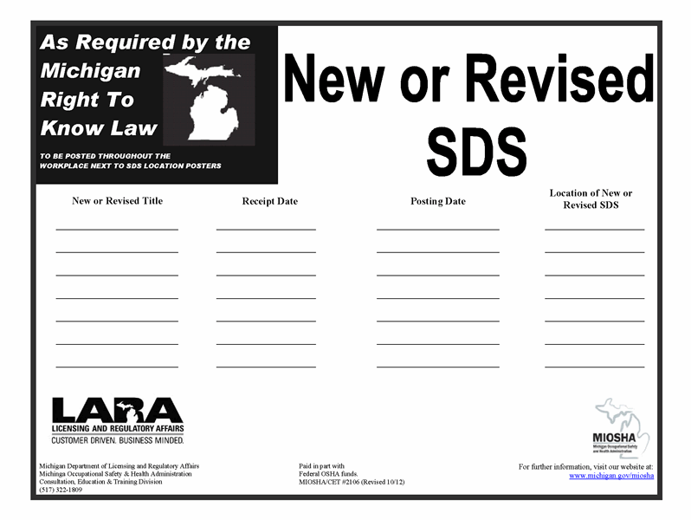
Revised Posters – MSDS to SDS

Slide 27
Your Responsibilities
Ensure that all secondary containers are labeled correctly
Provide an SDS for all products at your station
Know where to find SDS and labeling in the department’s SDS Information Station

Slide 28
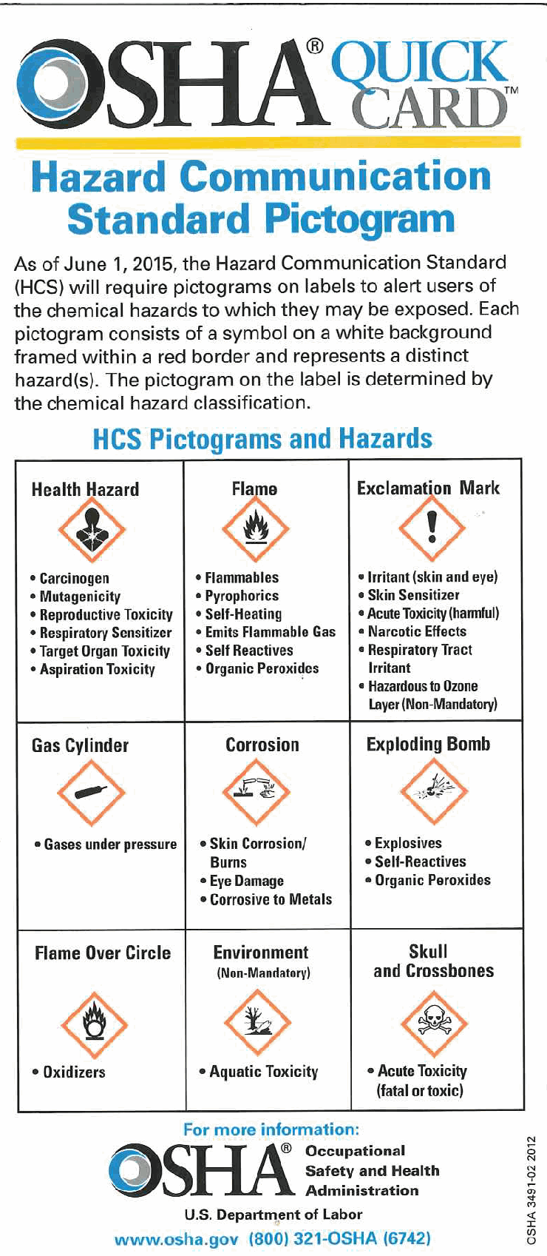
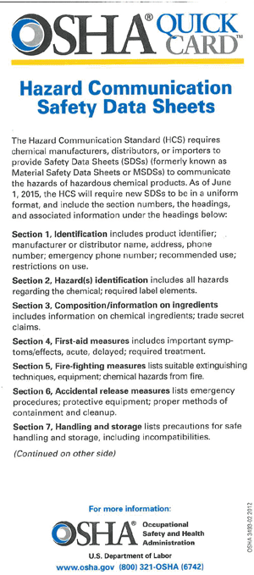
Federal OSHA Resources
Haz Com Web Page - www.osha.gov/dsg/hazcom/index.html
Regulatory
Haz Com 2012 Final Rule
Haz Com Comparison: Haz Com 1994 and 2012
  Side-by-side
  Redline Strikeout of the Regulatory Text
FAQs
Guidance
OSHA Briefs
Fact Sheet
Quick Cards
  Labeling
  Safety Data Sheets
  Pictograms
  Effective Dates
OSHA Guide to GHS
www.osha.gov/dsg/hazcom/ghs.html
GHS documents (links to purple book)

